Slide 1

Acropolis Institute of Technology & Research, Indore
www.acropolis.in

Slide 2

DealOye: An online platform for buying and selling study materials using web development technologies
Submitted to: Department of Information Technology

Slide 3
Team Members 1. Pavendra Singh Rajput (0827IT211081) 2. Soni Rathore (0827IT211112) 3. Vidhi Goyal (0827IT211128) 4. Vikas Agrawal (0827IT211130)
Supervised by: Prof. Shahida Khan
‹#›

Slide 4
Project Presentation Outline
Abstract
Introduction
Problem Statement
Survey of Existing Systems
Project Objectives
Requirement Analysis
Solution Proposed
The Outcome Discussion
Conclusions and Limitations
‹#›

Slide 5
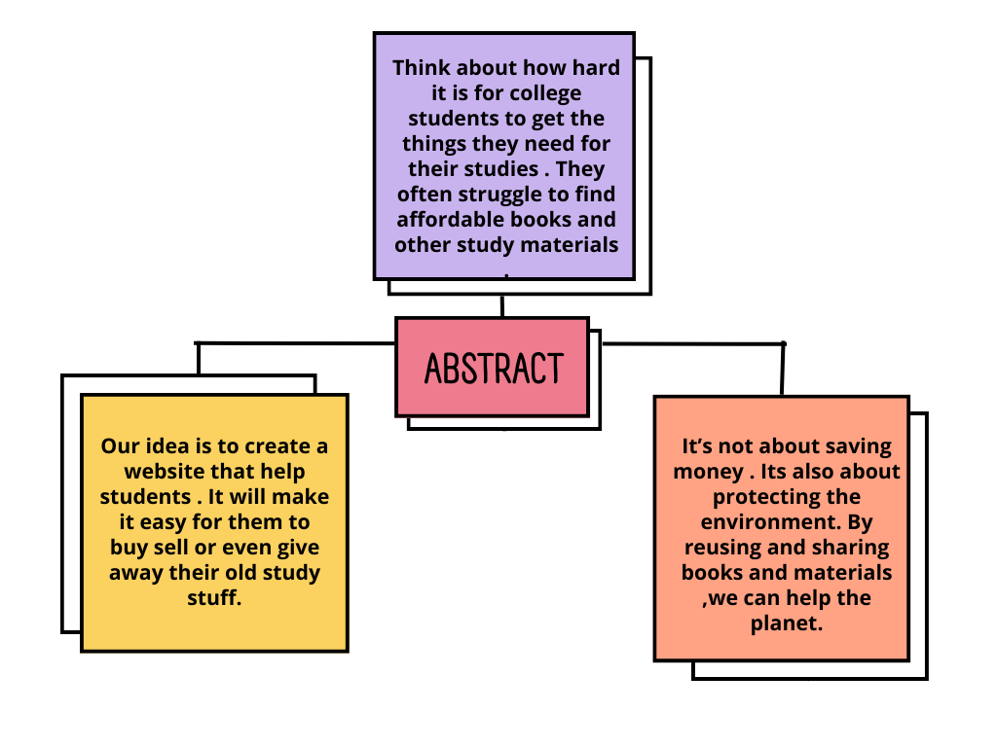
Abstract
‹#›

Slide 6
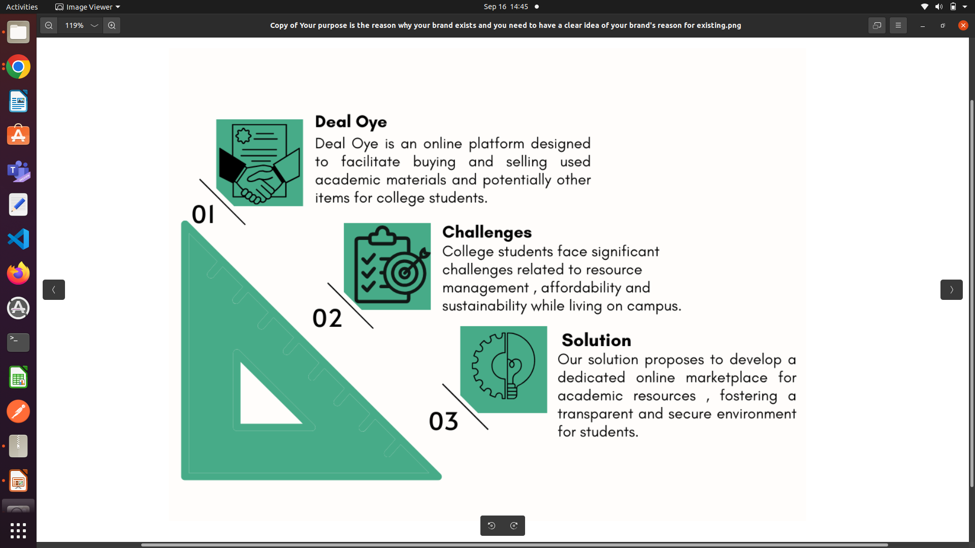
Introduction
‹#›

Slide 7
The Problem Statement
Problem Statement ID | SM957
Problem Statement Title | Addressing Challenges in College Student Resource Management
Description | College students in India confront a myriad of challenges related to resource management, affordability, and environmental sustainability while residing on campus. The current methods for buying and selling items lack transparency and security, posing issues for students. Moreover, accessing affordable educational resources remains a significant barrier to academic success. The project aims to develop a platform that addresses these challenges, providing a transparent, secure, and sustainable solution for college students to manage resources and access affordable educational materials.
Organization | AICTE, MIC-Student Innovation
Category | Software
‹#›

Slide 8
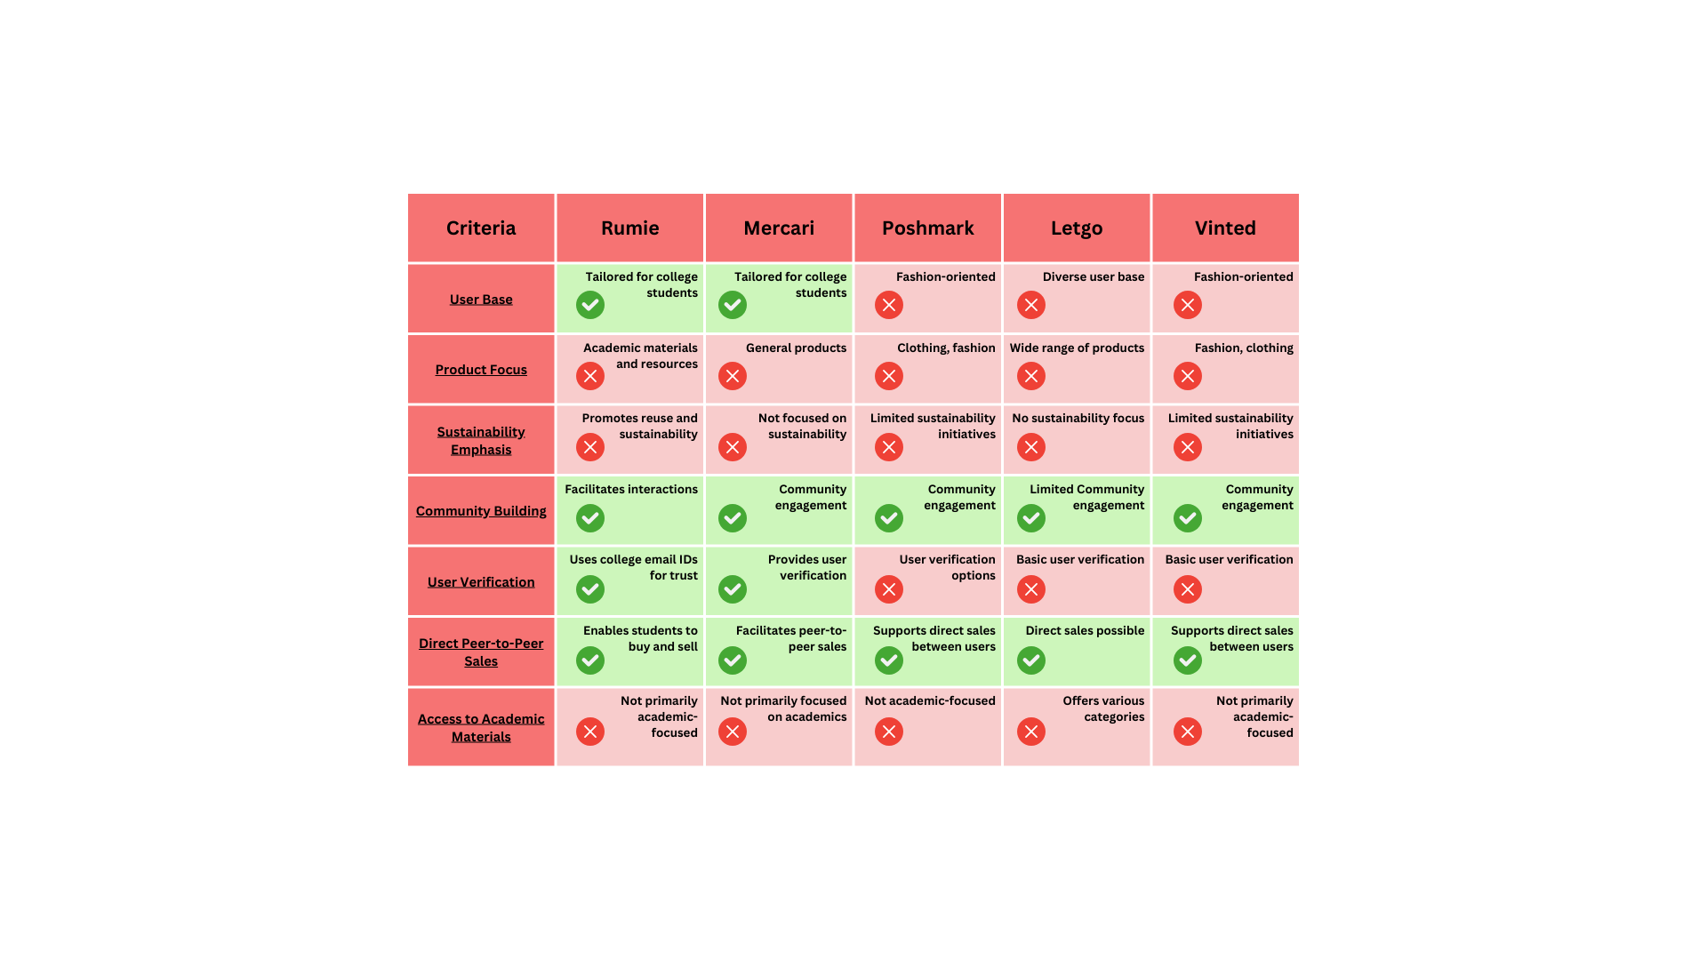
Survey of Existing Systems
‹#›

Slide 9
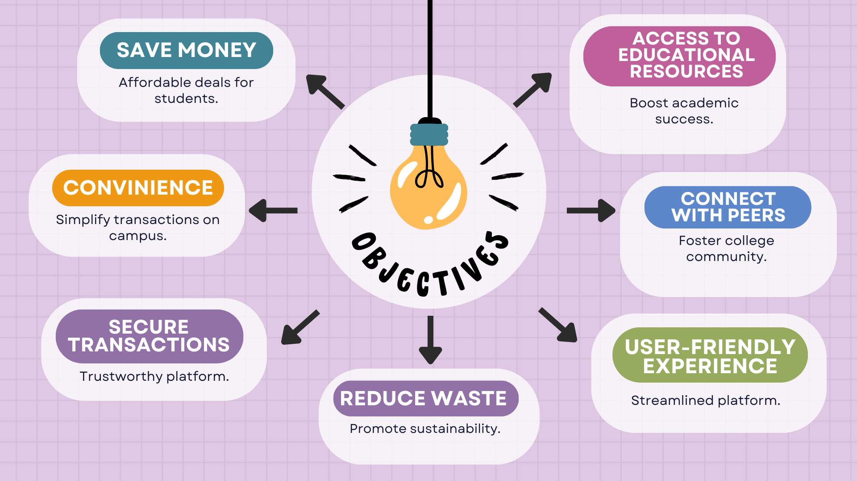
Objectives
‹#›

Slide 10
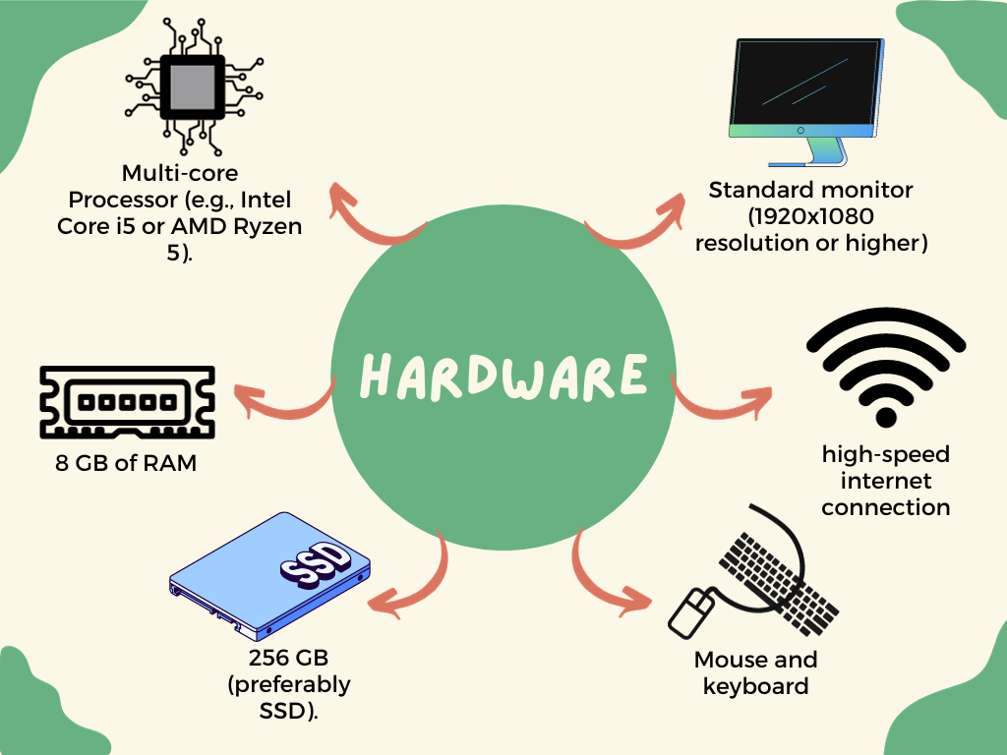
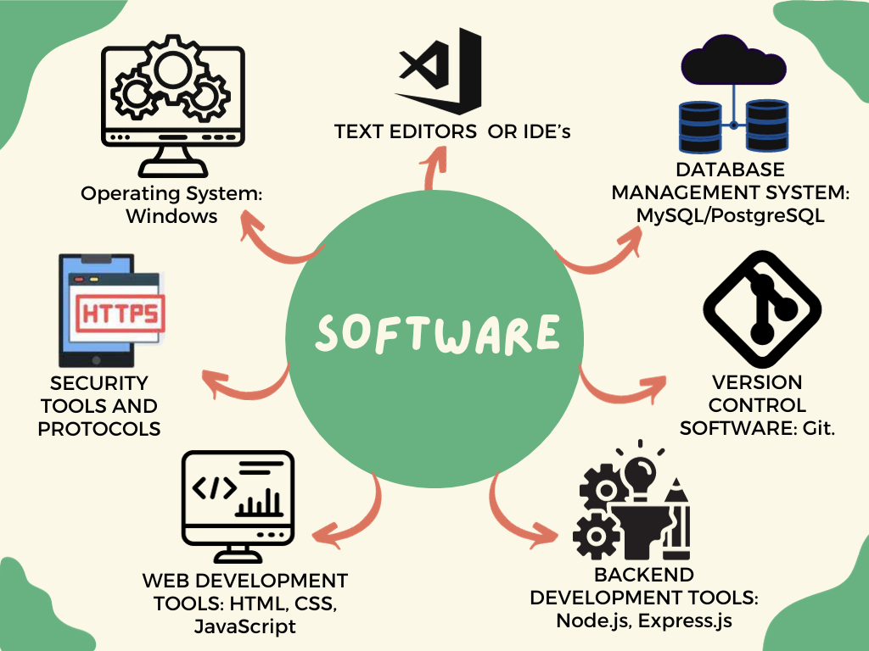
Requirement Analysis
‹#›

Slide 11
Solution Proposed
User Authentication:
Implemented a login/signup system with OTP verification to ensure secure access.
Product Listings:
Created a feature to display featured products on the homepage for easy browsing.
Search Functionality:
Users can search for specific products, enhancing user experience.
Buy Section:
Listed items available for purchase from other students, with "Wishlist" and "Contact" buttons for easy engagement.
Sell Section:
Sellers can manage their listings, mark availability, and remove items directly.
Requirements Section:
Users can post their product requirements and view others' needs along with contact details.
Dashboard:
Displays a summary of user-specific actions—wishlist, items for sale, and posted requirements.
Tech Stack:
Built using HTML, CSS, JavaScript, Node.js, Express.js, MongoDB, and API integration for seamless functionality.
‹#›

Slide 12
The Outcome Discussion
Enhanced College Community Interaction:
Facilitates interaction between senior and junior students.
Fosters mentorship, knowledge sharing, and community within the college.
Environmental Impact:
Promotes reuse and recycling, reducing campus waste.
Cost Savings:
Helps students find affordable used items.
Particularly beneficial for freshmen and international students on tight budgets.
Skill Development:
Sellers gain experience in entrepreneurship, marketing, and customer service.
Enhances personal and professional development.
Revenue Generation:
Potential for revenue through advertising, premium features, or transaction fees as the platform grows.
‹#›

Slide 13
Conclusion
Peer-to-Peer Commerce:
Facilitates direct transactions among college students.
Creates a platform for buying and selling within the campus community.
Connecting Generations:
Bridges the gap between senior and junior students.
Promotes interaction and knowledge sharing to enhance the college experience.
Reducing Environmental Impact:
Encourages reuse and recycling on campus.
Contributes to sustainability by minimizing waste.
Empowering Student Economy:
Empowers students to develop entrepreneurial skills.
Offers valuable experience in marketing, negotiation, and e-commerce for future careers.
‹#›

Slide 14
Limitation
Limited User Base:
The success of the website is contingent on widespread adoption within the college community.
Low user participation may diminish the overall impact and effectiveness of the platform.
Maintenance and Moderation:
Regular updates and maintenance are essential for optimal website performance.
Managing content and user interactions can be time-consuming, necessitating dedicated efforts to ensure a seamless user experience.

Slide 15
Acknowledgment
We are deeply grateful to our project guide Prof. Shahida Khan for his invaluable guidance and constant encouragement throughout this project. We would also like to thank Prof. Prashant Lakkadwala, HOD of Computer Engineering, for providing us the facilities required. We sincerely appreciate the support from all the faculty and staff members of the Information Technology Department. Finally, we thank our college management for giving us this wonderful opportunity.
18 August 2022
‹#›

Slide 16
Q&A
‹#›

Slide 17
THANKS
18 August 2022
‹#›

